Slide 1


Enron Americas (“EA”)
Enron Global Markets (“EGM”)
Enron Industrial Markets (“EIM”)
Flash to Actual
Audit Report
September 25, 2001
Confidential
Enron Assurance Services

Slide 2
Flash to Actual Audit
Project Objective (EA, EGM, & EIM):
Our review was designed to identify and test key policies, procedures, and controls related to:
❶ the tie-out between the Management Summary and Hyperion
❷ the reconciliations between the Daily Position Report (“DPR”) and General Ledger (“G/L”) by
product
❸ the causes for and frequency of reconciling items and the magnitude of these variances
❹ the reasonableness of frequent and infrequent reconciling items
AA Team Members:
Enron Team Members:
EA
EGM
EIM
Tom Bauer
Georganne Hodges
Tom Myers
Allen Ueckert
John Boudreaux
Greg Whiting
Jeff Smith
Darin Talley
Kate Agnew
Elaine Schield
Mike Moscoso
Mark Meador
Sarah Brown
Angeles Beltri
Tracy Irvin
Mark Medwedeff
Kristen Hanson
Allen Capps
Cassie Mayeux
Shelly Wood
Robin Dupuis
Donnie Myers

Slide 3
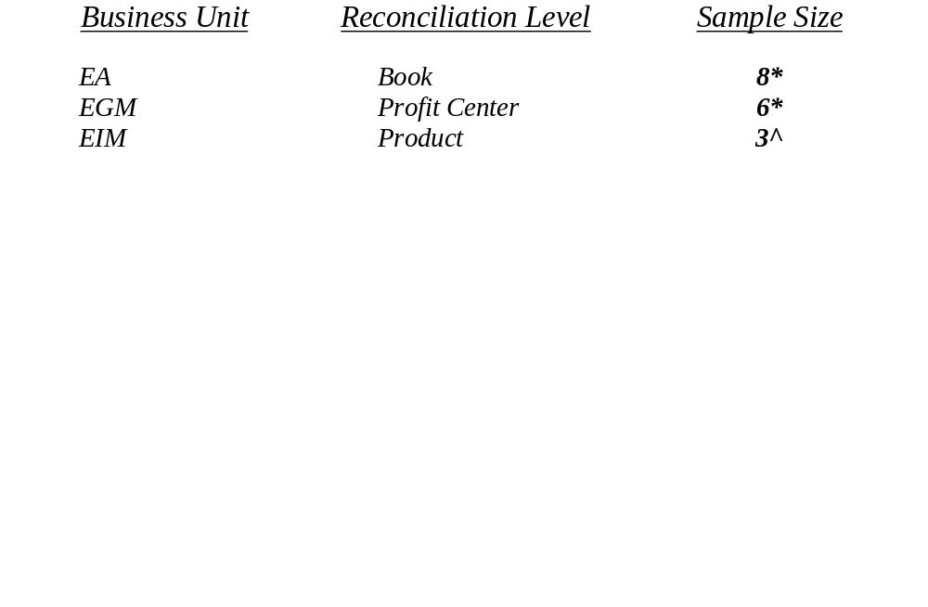
Flash to Actual Sample Summary
DPR to G/L Reconciliations
Testing Procedures
AALLP reviewed the entire population of DPR to G/L reconciliations from 1/1/01 to 6/30/01 by business unit and selected a sample as detailed below:
* Judgmentally selected based on risk and volume
^ Represents all reconciliations (Paper, Lumber, & Steel)
From these samples, we judgmentally selected various frequent and infrequent reconciling items and requested and reviewed the associated support. We also met with client personnel and discussed the items selected, in order to gain a better understanding of the cause behind the specific items and the procedures conducted to clear those items.

Slide 4
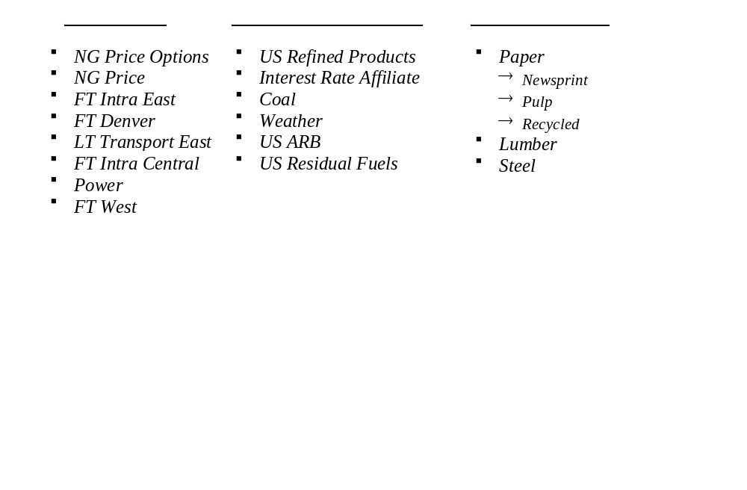
Flash to Actual Sample Summary
DPR to G/L Reconciliations
Testing Procedures
AALLP reviewed the entire population of DPR to G/L reconciliations from 1/1/01 to 6/30/01 by business unit and selected a sample as detailed below:

Slide 5
Flash to Actual Sample Summary
DPR to G/L Reconciliations
Frequent Reconciling Items:
Incorrect general journal (FI) entries
  Duplicated entries - booked twice
  Entries booked in reverse - debits that should have been credits
  G/L entries that did not get booked in the proper month are being booked in subsequent months
Entries booked to the the wrong Profit Center or book
Inter-month timing differences between what has liquidated in one month and settled in a subsequent month.
Outstanding 2000 items due to lack of time and resources in financial settlements as well as due to the complexities of the conversion from MSA to SAP
95 day true-up for weather products causing the need for a G/L adjustment
Items that were booked as settled but not recognized as liquidated on the DPR because not properly captured in the liquidation system
Gas Daily rates are incorrect when the last day of the month falls on a weekend
Occasional differences between systems (for example, differences TAGG & ERMS) are allowed to flow through as reconciling items to be cleared once the Settlements group books the correct amount

Slide 6
Flash to Actual
Sample Summary
DPR to G/L Reconciliations
Infrequent Reconciling Items:
Category on reconciliations called “NYMEX Income” where amounts booked to the G/L are incorrect due to accounting errors
Broker fees not completely captured or not captured at all in the DPR
Entries that should have auto-reversed in prior months that did not auto-reverse
Changes in P&L due to the incorrect capture of closing prices
Deals entered incorrectly into the system (for example TAGG) as financial instead of physical
Transportation Spreads not discovered as a reconciling item during the financial close process are discovered during the DPR to G/L reconciliation process and cause a need to adjust the G/L

Slide 7
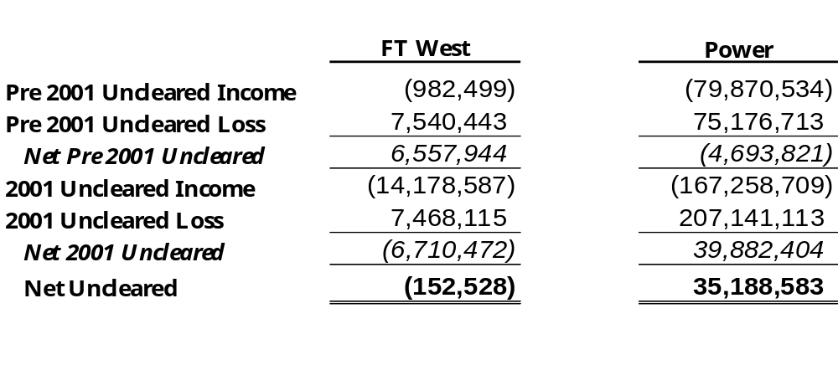
Flash to Actual
Outstanding Reconciling Statistics
DPR to G/L Reconciliations
Enron Americas
As of June 30, 2001
The following books were selected for further disclosure from our sample based upon risk and volume.

Slide 8
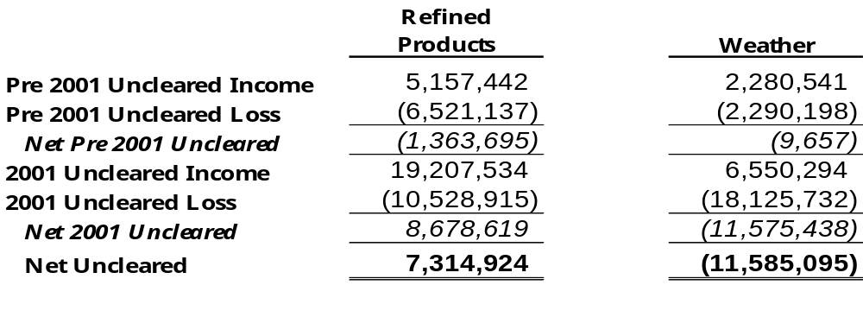
Flash to Actual
Outstanding Reconciling Statistics
DPR to G/L Reconciliations
Enron Global Markets
As of June 30, 2001
The following profit centers were selected for further disclosure from our sample based upon risk and volume.

Slide 9
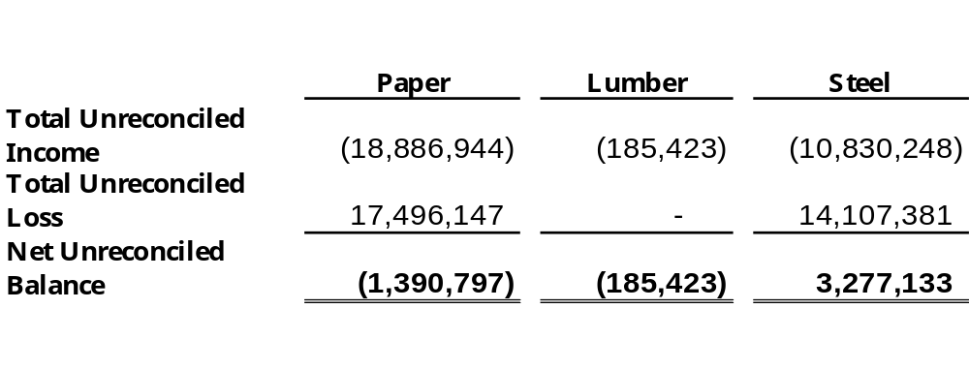
Flash to Actual
Outstanding Reconciling Statistics
DPR to G/L Reconciliations
Enron Industrial Markets
As of July 31, 2001

Slide 10
Flash to Actual
High Priority Items

Slide 11
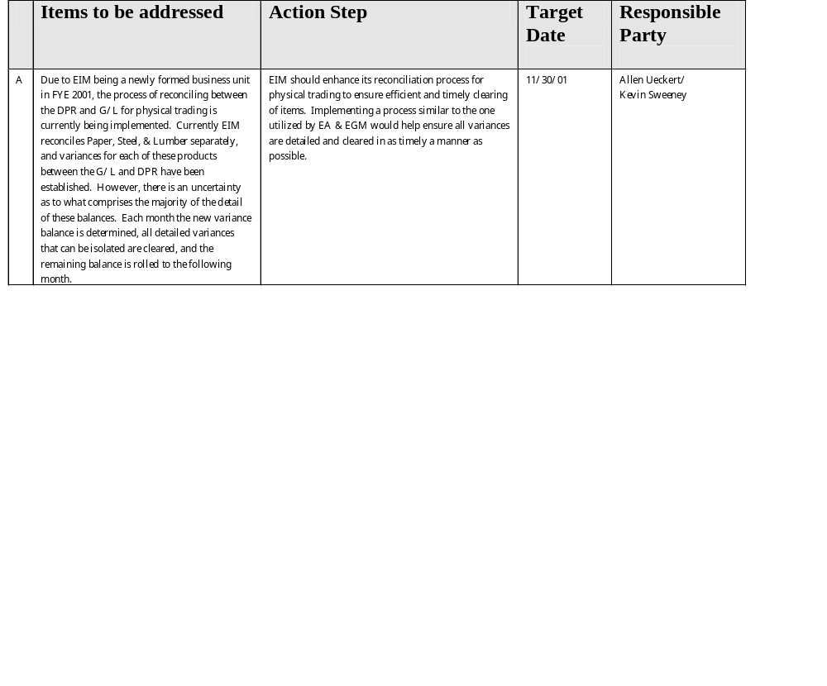
Flash to Actual Audit Observations
High Priority

Slide 12
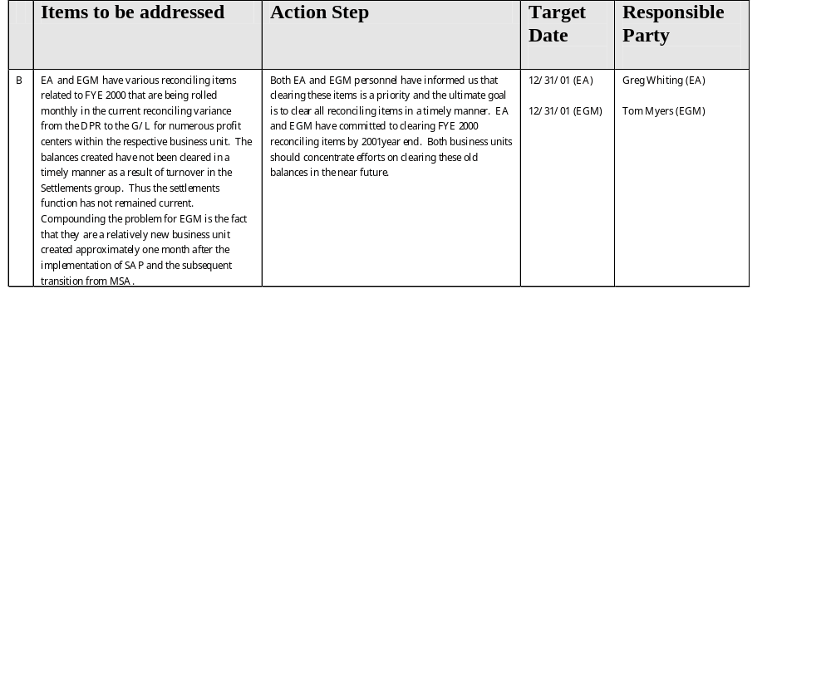
Flash to Actual Audit Observations
High Priority

Slide 13
Flash to Actual Audit
Low Priority Items

Slide 14
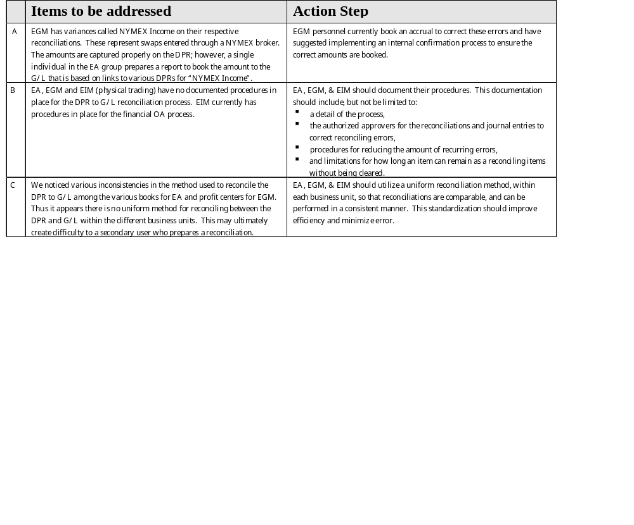
Flash to Actual Audit Observations
Low Priority

